Slide 1
Text
Chapters 1, 2

Slide 2
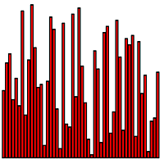
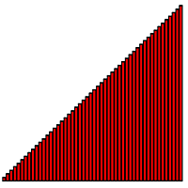


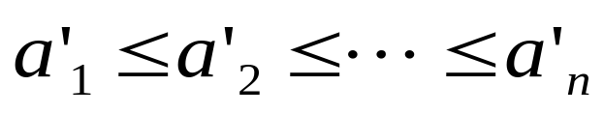
Sorting
Algorithm:
  well-defined computational procedure that transforms input into output
  steps for the computer to follow to solve a problem
instance
Sorting Problem:
  Input: A sequence of n numbers
  Output: A permutation (reordering) of the input sequence such that:

Slide 3
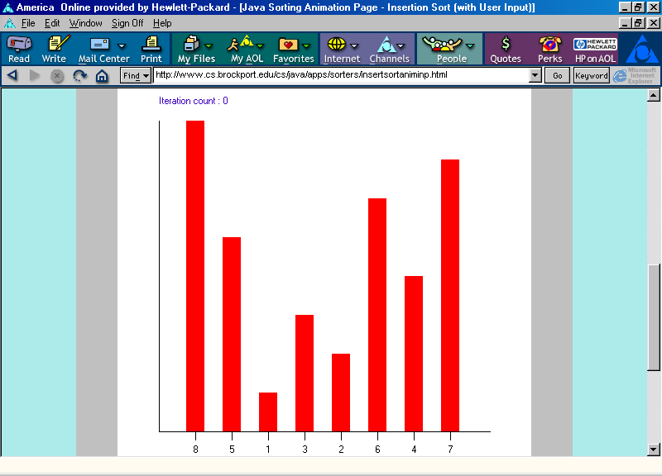
Insertion Sort Animation
Finding a place for item with value 5 in position 1:
Swap item in position 0 with item in position 1.
http://www.cs.brockport.edu/cs/java/apps/sorters/insertsortaniminp.html

Slide 4
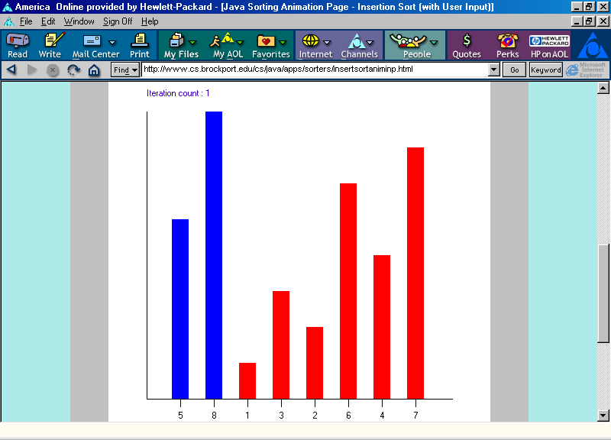
Insertion Sort Animation
Positions 0 through 1 are now in non-decreasing order.
http://www.cs.brockport.edu/cs/java/apps/sorters/insertsortaniminp.html

Slide 5
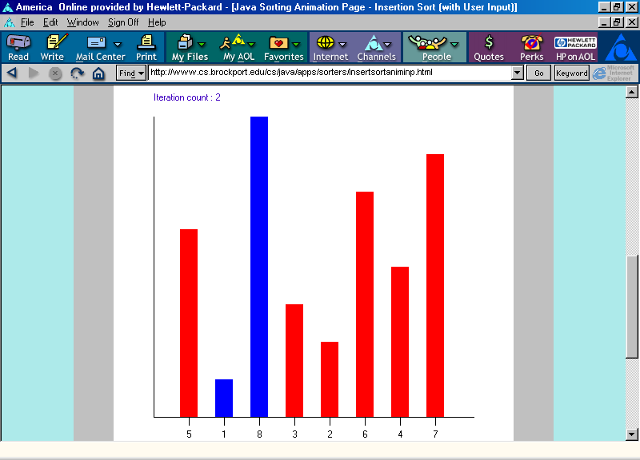
Insertion Sort Animation
Finding a place for item with value 1 in position 2:
Swap item in position 1 with item in position 2.
http://www.cs.brockport.edu/cs/java/apps/sorters/insertsortaniminp.html

Slide 6
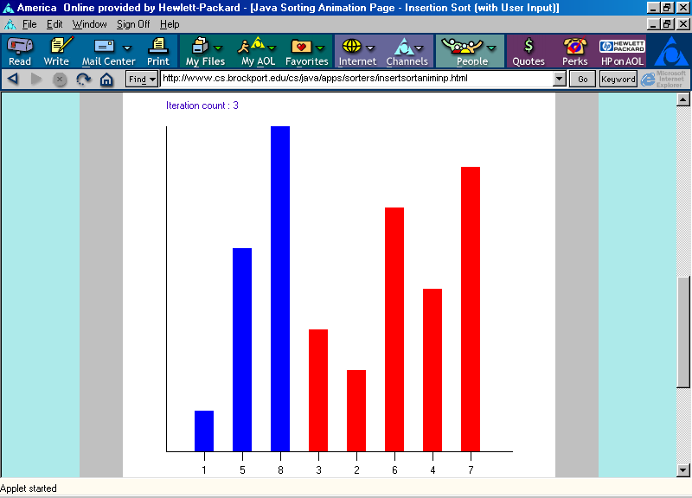
Insertion Sort Animation
Finding a place for item with value 1:
Swap item in position 0 with item in position 1.
Positions 0 through 2 are now in non-decreasing order.
http://www.cs.brockport.edu/cs/java/apps/sorters/insertsortaniminp.html

Slide 7
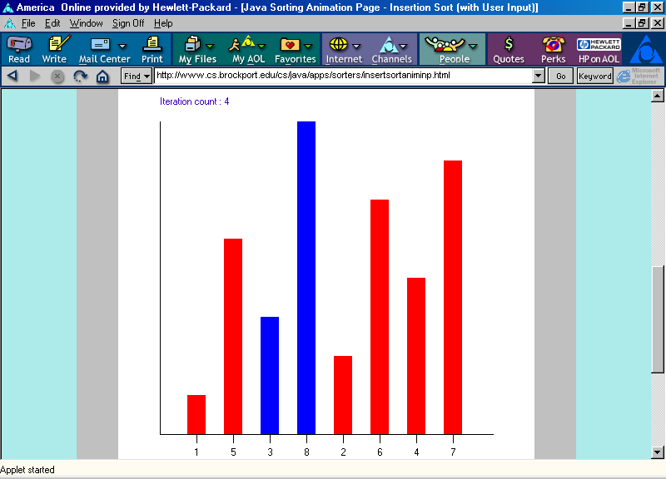
Insertion Sort Animation
Finding a place for item with value 3 in position 3:
Swap item in position 2 with item in position 3.
http://www.cs.brockport.edu/cs/java/apps/sorters/insertsortaniminp.html

Slide 8
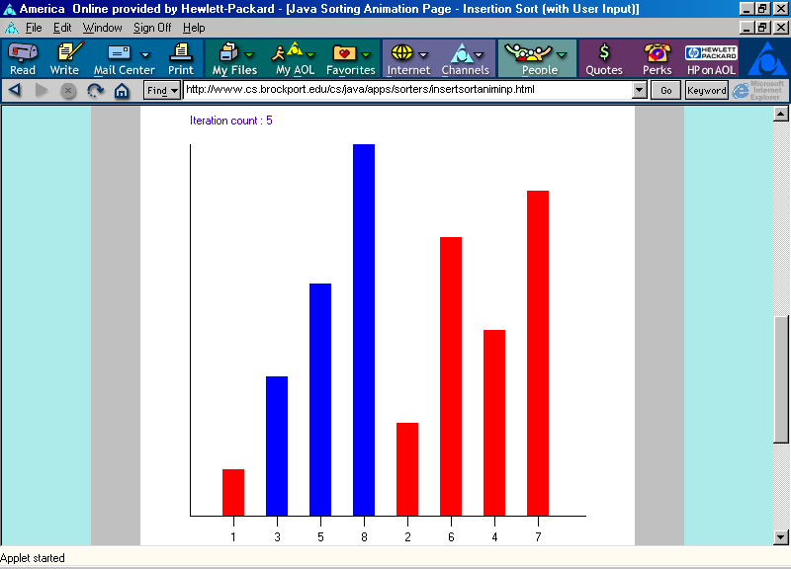
Insertion Sort Animation
Finding a place for item with value 3:
Swap item in position 1 with item in position 2.
http://www.cs.brockport.edu/cs/java/apps/sorters/insertsortaniminp.html

Slide 9
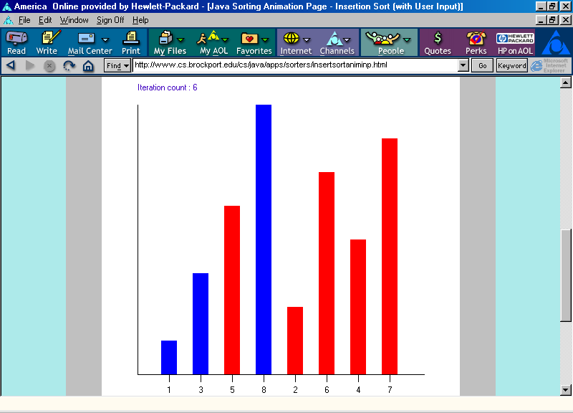
Insertion Sort Animation
Positions 0 through 3 are now in non-decreasing order.
http://www.cs.brockport.edu/cs/java/apps/sorters/insertsortaniminp.html

Slide 10
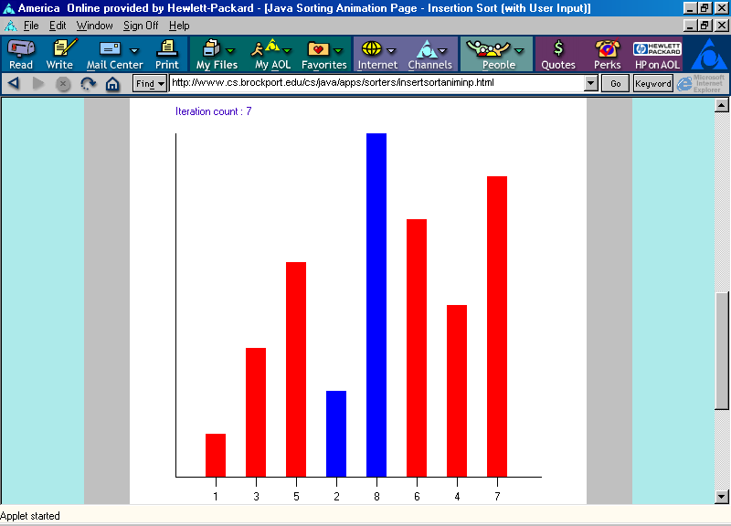
Insertion Sort Animation
Finding a place for item with value 2 in position 4:
Swap item in position 3 with item in position 4.
http://www.cs.brockport.edu/cs/java/apps/sorters/insertsortaniminp.html

Slide 11
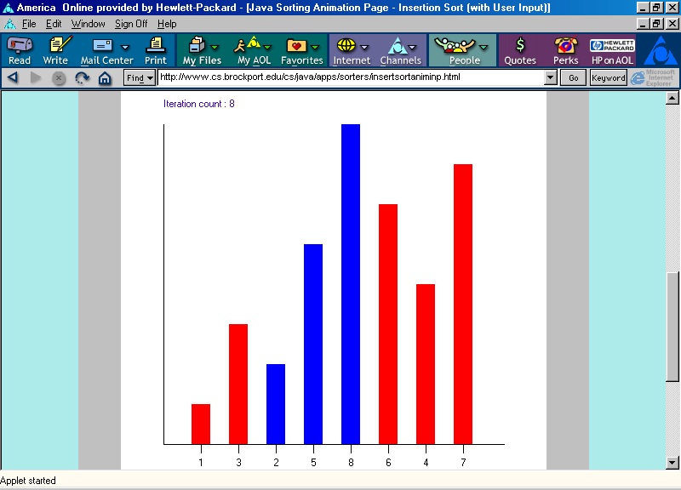
Insertion Sort Animation
Finding a place for item with value 2:
Swap item in position 2 with item in position 3.
http://www.cs.brockport.edu/cs/java/apps/sorters/insertsortaniminp.html

Slide 12
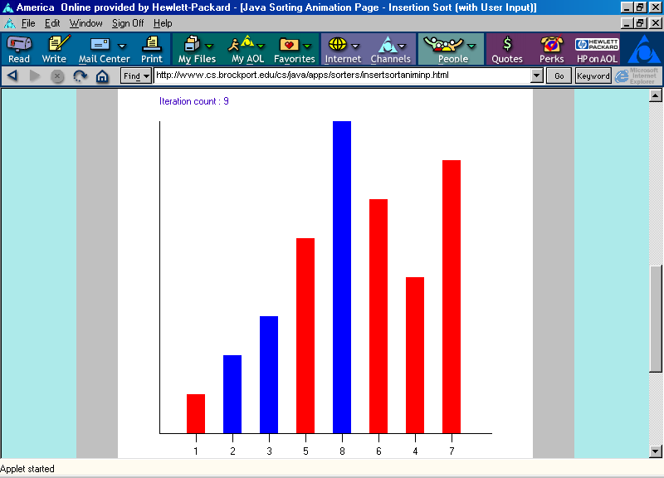
Insertion Sort Animation
Finding a place for item with value 2:
Swap item in position 1 with item in position 2.
http://www.cs.brockport.edu/cs/java/apps/sorters/insertsortaniminp.html

Slide 13
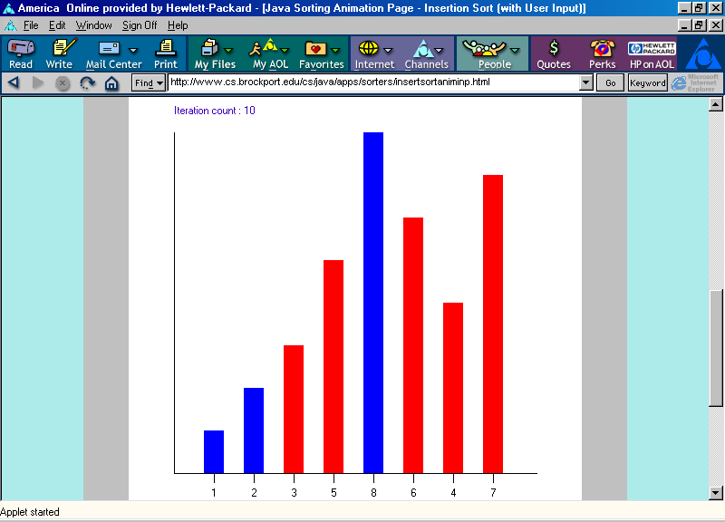
Insertion Sort Animation
Positions 0 through 4 are now in non-decreasing order.
http://www.cs.brockport.edu/cs/java/apps/sorters/insertsortaniminp.html

Slide 14
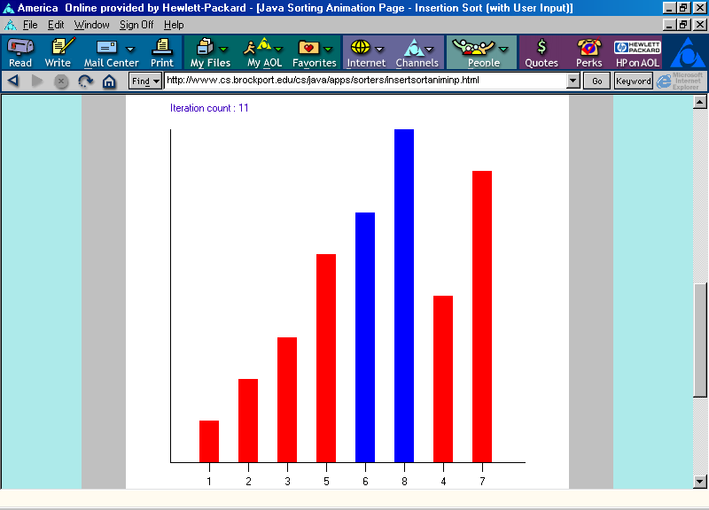
Insertion Sort Animation
Finding a place for item with value 6 in position 5:
Swap item in position 4 with item in position 5.
http://www.cs.brockport.edu/cs/java/apps/sorters/insertsortaniminp.html

Slide 15
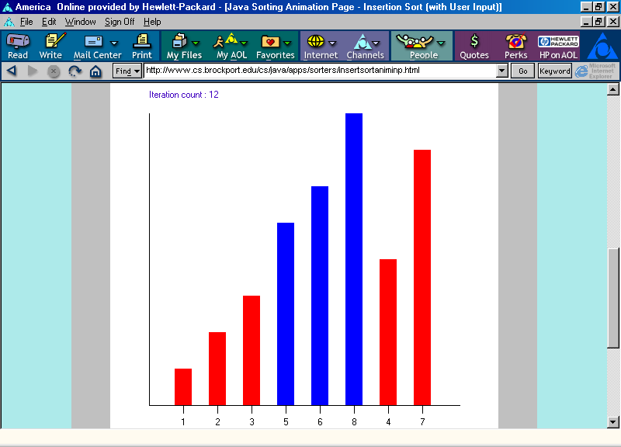
Insertion Sort Animation
Positions 0 through 5 are now in non-decreasing order.
http://www.cs.brockport.edu/cs/java/apps/sorters/insertsortaniminp.html

Slide 16
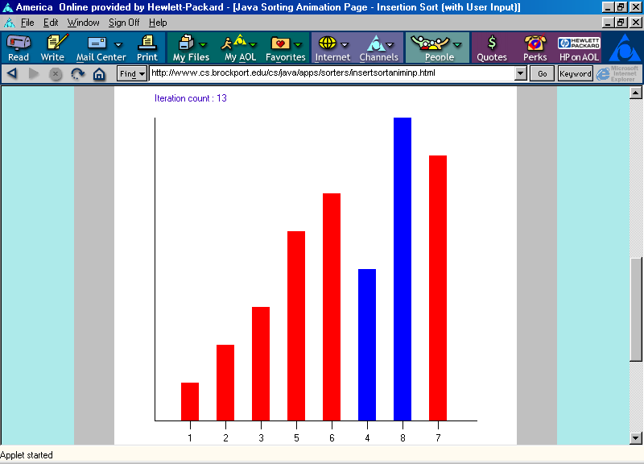
Insertion Sort Animation
Finding a place for item with value 4 in position 6:
Swap item in position 5 with item in position 6.
http://www.cs.brockport.edu/cs/java/apps/sorters/insertsortaniminp.html

Slide 17
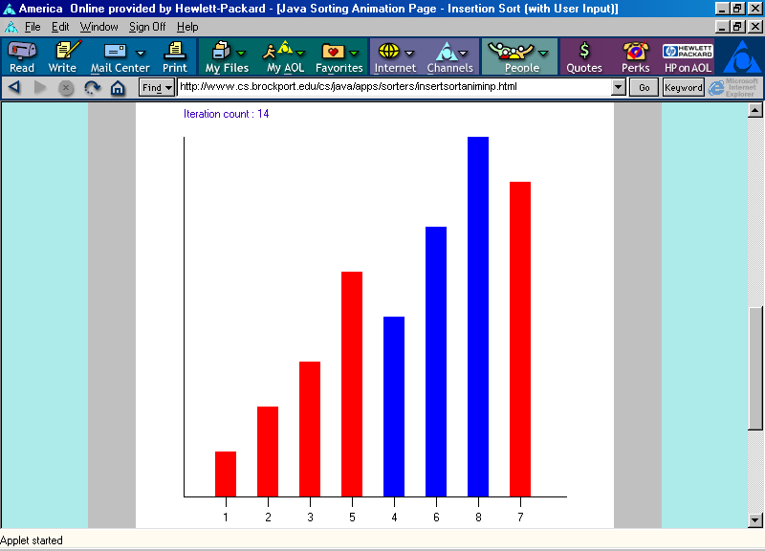
Insertion Sort Animation
Finding a place for item with value 4:
Swap item in position 4 with item in position 5.
http://www.cs.brockport.edu/cs/java/apps/sorters/insertsortaniminp.html

Slide 18
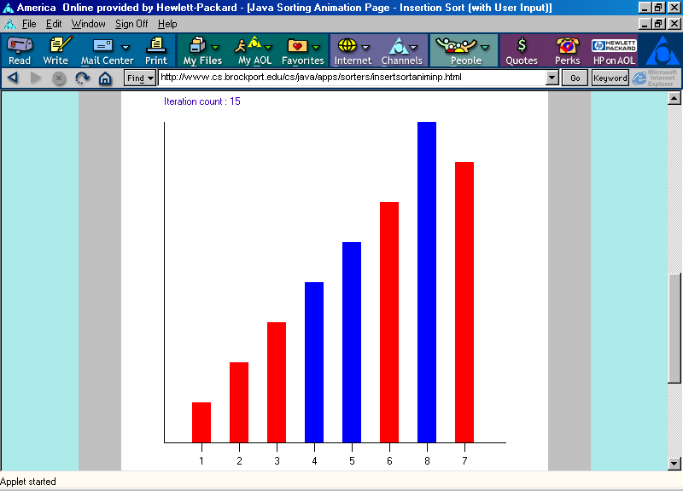
Insertion Sort Animation
Positions 0 through 6 are now in non-decreasing order.
http://www.cs.brockport.edu/cs/java/apps/sorters/insertsortaniminp.html

Slide 19
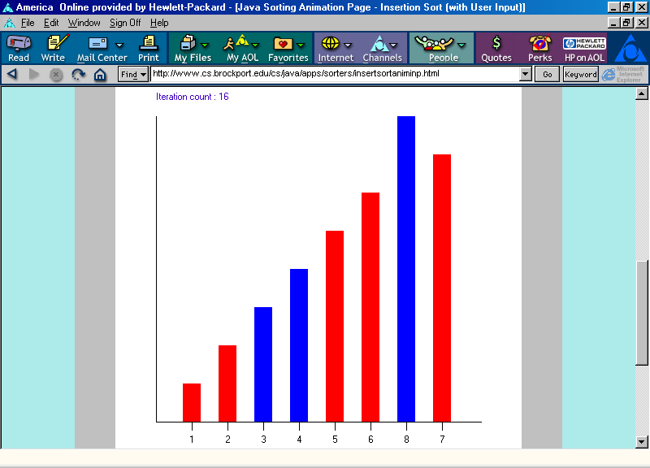
Insertion Sort Animation
Finding a place for item with value 7 in position 7:
Swap item in position 6 with item in position 7.
http://www.cs.brockport.edu/cs/java/apps/sorters/insertsortaniminp.html

Slide 20
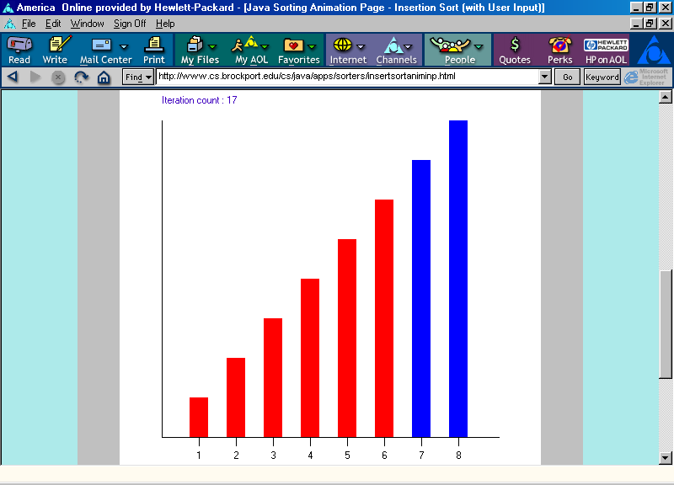
Insertion Sort Animation
Positions 0 through 7 are now in non-decreasing order.
http://www.cs.brockport.edu/cs/java/apps/sorters/insertsortaniminp.html

Slide 21
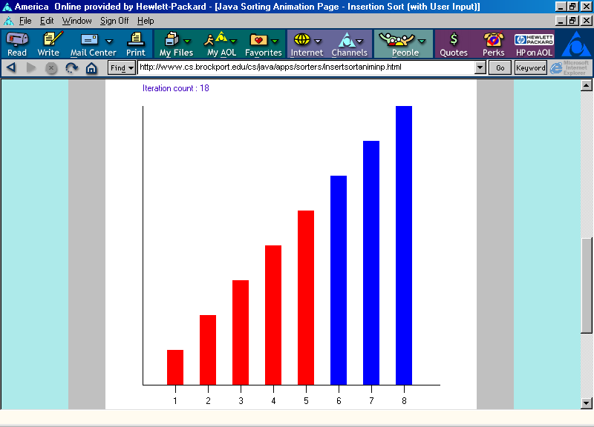
Insertion Sort Animation
Positions 0 through 7 are now in non-decreasing order.
http://www.cs.brockport.edu/cs/java/apps/sorters/insertsortaniminp.html

Slide 22
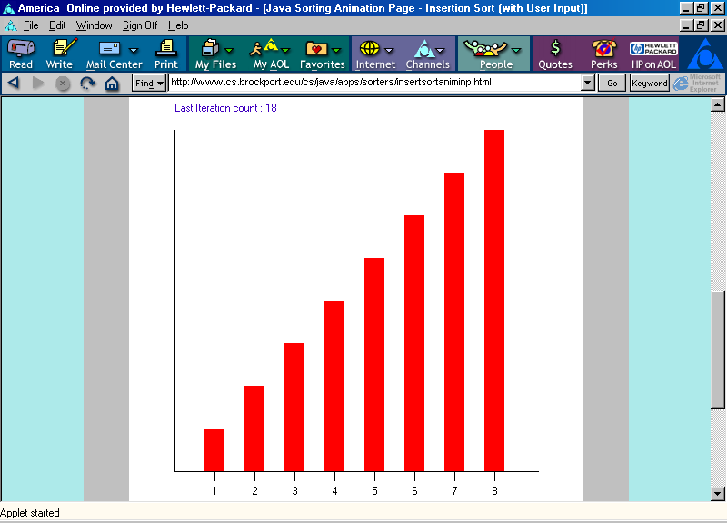
Insertion Sort Animation
Positions 0 through 7 are now in non-decreasing order.
http://www.cs.brockport.edu/cs/java/apps/sorters/insertsortaniminp.html

